Slide 1



The Machine Learning Landscape

Slide 2




WHAT IS MACHINE LEARNING?
Machine Learning is the science (and art) of programming computers so they can learn from data.

Slide 3


Problems for which existing solutions require a lot of fine-tuning or long lists of rules: one Machine Learning algorithm can often simplify code and perform better than the traditional approach.
Complex problems for which using a traditional approach yields no good solution: the best Machine Learning techniques can perhaps find a solution.
Fluctuating environments: a Machine Learning system can adapt to new data.
Getting insights about complex problems and large amounts of data.
WHY USE MACHINE LEARNING?

Slide 4




Types of Machine Learning Systems

Slide 5
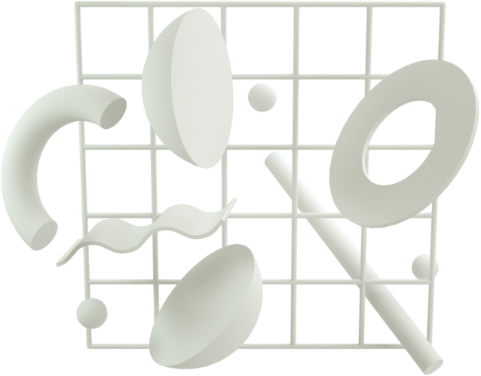



TYPES OF MACHINE LEARNING SYSTEMS
Whether or not they are trained with human supervision (supervised, unsupervised, semisupervised, and Reinforcement Learning )
Whether or not they can learn incrementally on the fly (online versus batch learning)
Whether they work by simply comparing new data points to known data points, or instead by detecting patterns in the training data and building a predictive model, much like scientists do (instance-based versus model-based learning)

Slide 6

Whether or not they are trained with human supervision

Slide 7

In supervised learning, the training set you feed to the algorithm includes the desired solutions, called labels
Classification: predict a category, all off small set from possible outputs
Regression: predict a number from infinitely many possible outputs
SUPERVISED LEARNING

Slide 8
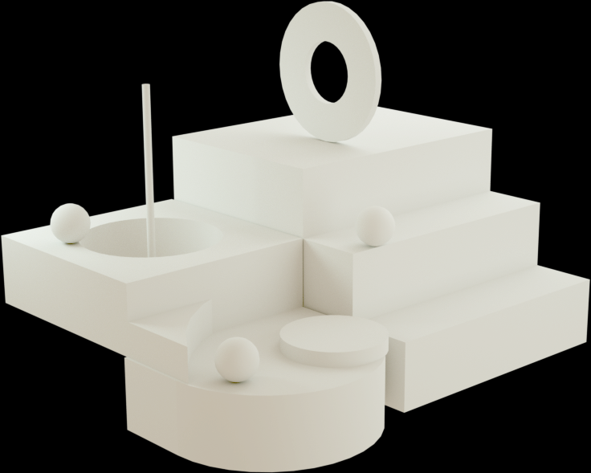

In unsupervised learning, the training data is unlabeled . The system tries to learn without a teacher.
UNSUPERVISED LEARNING
Clustering: the task of dividing the population or data points into a number of groups such that data points in the same groups are more similar to other data points in the same group and dissimilar to the data points in other groups
Visualization and dimensionality reduction:
Visualization algorithms: you feed them a lot of complex and unlabeled data, and they output a 2D or 3D rep‐ resentation of your data that can easily be plotted.
Dimensionality reduction: to simplify the data without losing too much information. There are two ways to do this:
Feature Selectiong:
Feature Extraction: merge several correlated features into one

Slide 9
UNSUPERVISED LEARNING
Anomaly detection and novelty detection: Anomaly Detection: the process of locating unusual points or patterns in a set of data. Novelty detection: the process of detecting new instances that look different from all instances in the training set.
Association rule learning: dig into large amounts of data and discover interesting relations between attributes.

Slide 10

SEMISUPERVISED LEARNING
.Since labeling data is usually time-consuming and costly, you will often have plenty of unlabeled instances, and few labeled instances. Some algorithms can deal with data that’s partially labeled.
Most semisupervised learning algorithms are combinations of unsupervised and supervised algorithms

Slide 11
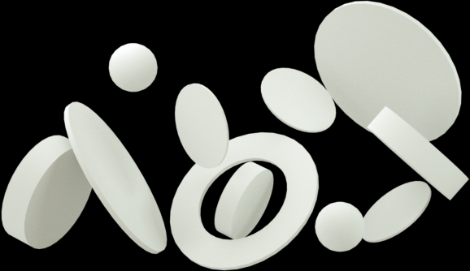
REINFORCEMENT LEARNING
The learning system, called an agent in this context, can observe the environment, select and perform actions, and get rewards in return. It must then learn by itself what is the best strategy, called a policy, to get the most reward over time. A policy defines what action the agent should choose when it is in a given situation.

Slide 12
Whether or not they can learn incrementally on the fly (online versus batch learning)

Slide 13
In batch learning, the system is incapable of learning incrementally: it must be trained using all the available data
BATCH LEARNIGN
Firstly, the system is trained, and then it is launched into production and runs without learning anymore; it just applies what it has learned.
To know about new data, people need to train a new version of the system from scratch on the full dataset, then stop the old system and replace it with the new one.
Disadvantage:
Training using the full set of data take many hour
requires a lot of computing resources
If the amount of data is huge, it may be impossible

Slide 14


ONLINE LEARNING
In online learning, you train the system incrementally by feeding it data instances sequentially, either individually or in small groups
Advangtage:
fast and cheap
learn about new data on the fly
can save a huge amount of space (discard new data instances which has learned if does not need them anymore.
can save a huge amount of space.
train systems on huge datasets

Slide 15
ONLINE LEARNING
Learning Rate:
Hight: rapidly adapt to new data but quickly forget the old data
Slow: earn more slowly but less sensitive to noise in the new data or to sequences of nonrepresentative data points
Disadvantage: if bad data is fed to the system, the system’s performance will gradually decline
Solution:
need to monitor your system closely and promptly switch learning off
monitor the input data and react to abnormal data

Slide 16
Whether they work by simply comparing new data points to known data points, or instead by detecting patterns in the training data and building a predictive model, much like scientists do

Slide 17
Instance-based learning
The system learns the examples by heart, then generalizes to new cases by using a similarity measure to compare them to the learned examples.
MODEL-BASED LEARNING
Another way to generalize from a set of examples is to build a model of these exam‐ ples and then use that model to make predictions

Slide 18


Main Challenges of Machine Learning

Slide 19
Insufficient Quantity of Training Data: it takes a lot of data for most Machine Learn‐ ing algorithms to work properly. For very simple problems you typically need thousands of examples, and for complex problems such as image or speech recogni‐ tion you may need millions of examples
BAD DATA
Nonrepresentative Training Data: In order to generalize well, it is crucial that your training data be representative of the new cases you want to generalize to

Slide 20
Poor-Quality Data: if your training data is full of errors, outliers, and noise, it will make it harder for the system to detect the underlying patterns, so your system is less likely to perform well.
BAD DATA
Irrelevant Features: System will only be capable of learn‐ ing if the training data contains enough relevant features and not too many irrelevant ones Feature engineering: + Feature selection + Feature extraction + Creating new features by gathering new data

Slide 21
BAD ALGORITHMS
Overfitting the Training Data: Overfitting happens when the model is too complex relative to the amount and noisiness of the training data.
Solution:
Simplify the model by selecting one with fewer parameters
Gather more training data
Reduce the noise in the training data
Underfitting the Training Data: It occurs when your model is too simple to learn the underlying structure of the data.
Solution:
Select a more powerful model, with more parameters
Feed better features to the learning algorithm
Reduce the constraints on the model

Slide 22


Testing and Validating

Slide 23
Hyperparameter Tuning and
Model Selection
Evaluating a model is simple enough: just use a test set.
You are hesitating between two types of models? One option is to train both and compare how well they generalize using the test set.
After choose model, you want to apply some regularization to avoid overfitting. The question is, how do you choose the value of the regularization hyperparameter? One option is to train 100 different models using 100 different values for this hyperparameter.

Slide 24
Hyperparameter Tuning and
Model Selection
The problem is that you measured the generalization error multiple times on the test set, and you adapted the model and hyperparameters to produce the best model for that particular set. This means that the model is unlikely to perform as well on new data? A common solution to this problem is called holdout validation: you simply hold out part of the training set to evaluate several candidate models and select the best one.

Slide 25
Data Mismatch
In some cases, it’s easy to get a large amount of data for training, but this data probably won’t be perfectly representative of the data that will be used in production.

Slide 26


